Slide 1
Meeting Reflection
Dec 30

Slide 2
Possible Implications Discussed in Meeting
The random variability in the simulation of PK may result in certain overlapping PK between neighboring doses (3-fold), therefore, it was reasonably expected that the AI training in the low dose group may actually include a certain PK range that covers some PK range in the 3-fold higher dose.
Action item: Evaluate the percentage of subjects, in the 3-fold higher dose, with PK out of the maximal range from the low dose, and whether PK/PD were able to be predicted for these subjects with high PK in the high dose.

Slide 3
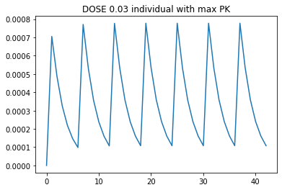
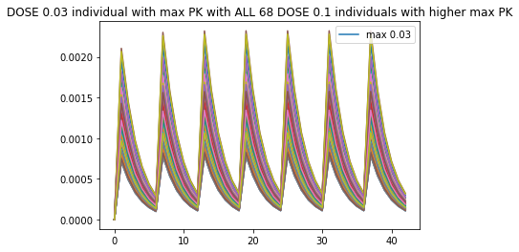
Results: PK comparisons between two neighbour doses
All doses: 0.03, 0.1, 0.3, 1.0, 3.0, 10.0, 30.0 mg. Number of subjects in the high dose that had a higher Cmax than the Max of the Cmax of the lower dose was about 60-70%. The highest difference is about 3-4 fold

Slide 4
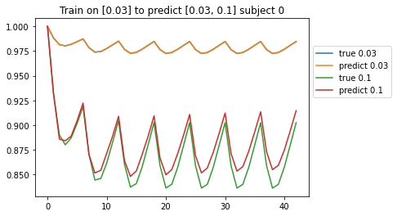
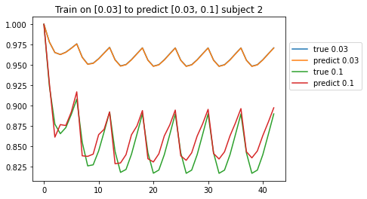
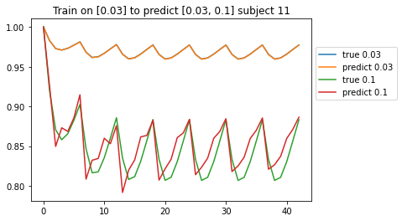
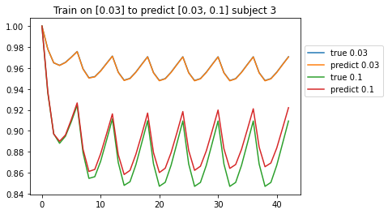
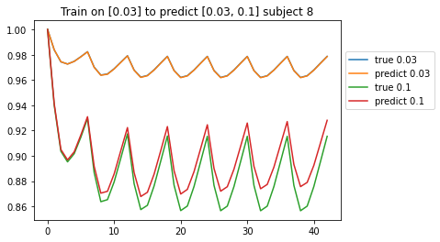
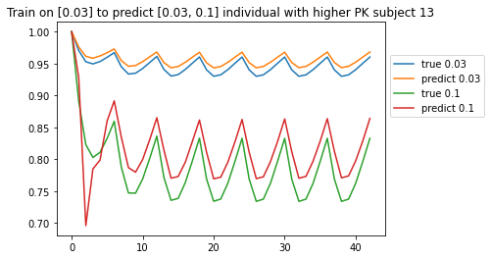
Results: PD prediction for individuals with higher PK in the high dose group (1)
Train on 0.03 mg to predict 0.1 mg individuals with PK > max PK of 0.03 mg: ALL had reasonable predictions (6 examples shown)

Slide 5
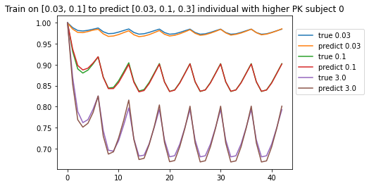
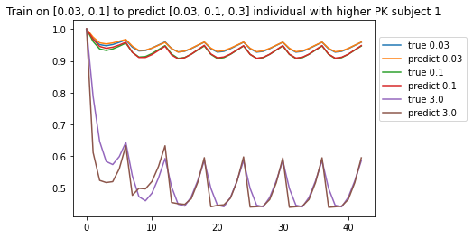
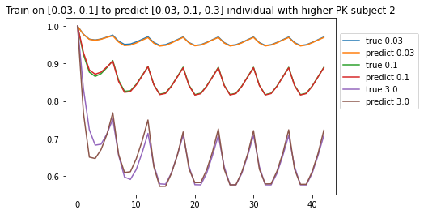
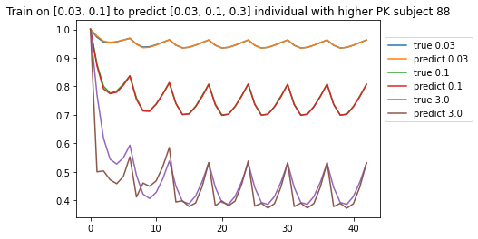
Results: PD prediction for individuals with higher PK in the high dose group (2)
Train on 0.03 and 0.1 mg to predict 0.3 mg individuals with PK > max PK of 0.1 mg: ALL had reasonable predictions (4 examples shown)

Slide 6
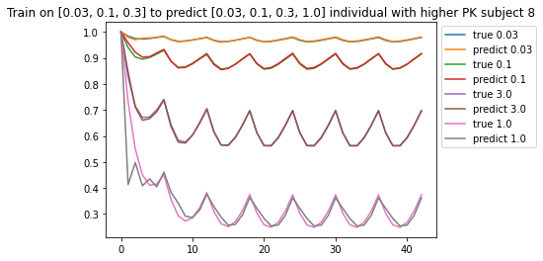
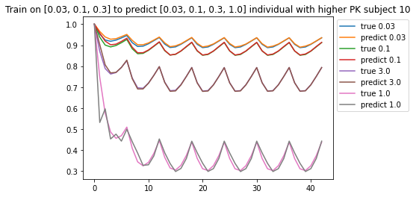
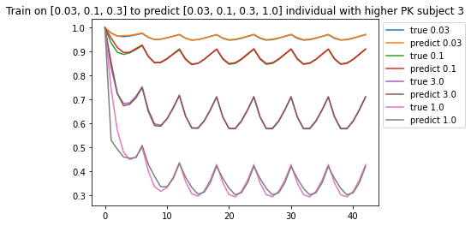
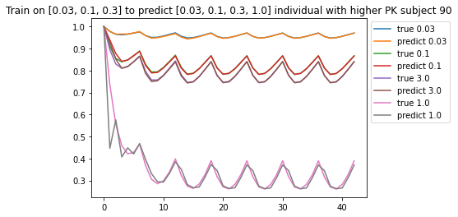
Results: PD prediction for individuals with higher PK in the high dose group (3)
Train on 0.03, 0.1 and 0.3 mg to predict 1 mg individuals with PK > max PK of 0.3mg: ALL had reasonable predictions (4 examples shown)

Slide 7
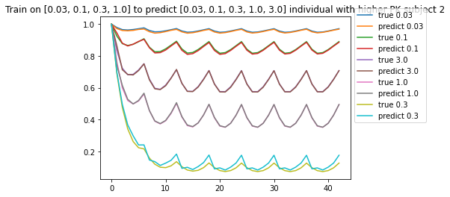
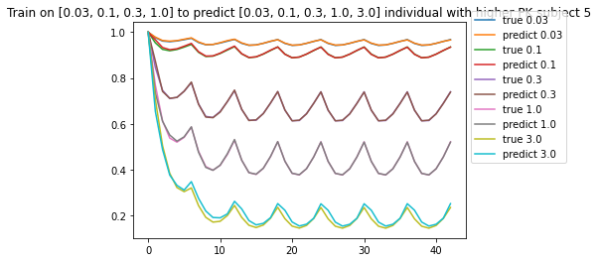
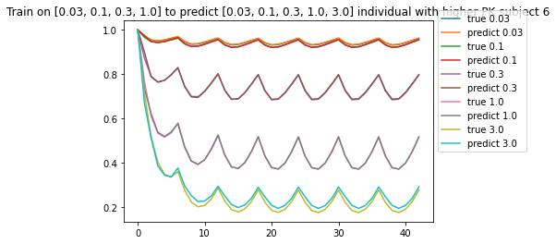
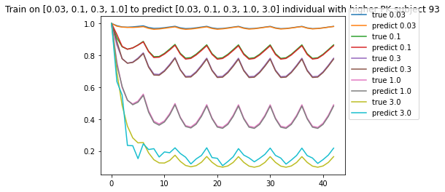
Results: PD prediction for individuals with higher PK in the high dose group (4)
Train on 0.03, 0.1, 0.3 and 1 mg to predict 3 mg individuals with PK > max PK of 1 mg: ALL had reasonable predictions (4 examples shown)

Slide 8
Conclusion for the implication from the Meeting
On the PK comparison at the individual level (between the 3-fold doses), the AI training at the low PK/PD can reasonably predict the higher PK/PD (at least 3-4 fold)
Next few slides have more data

Slide 9
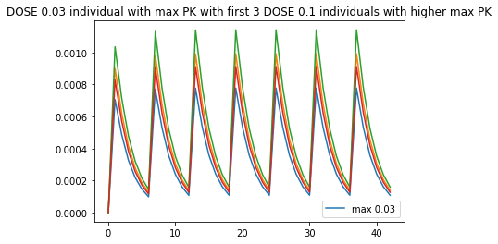
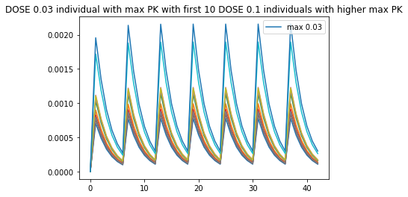

Slide 10
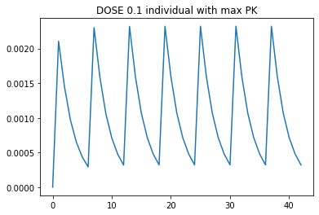
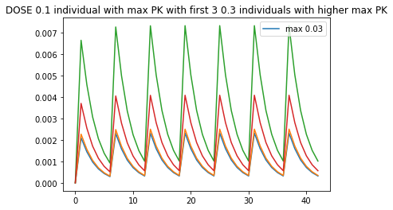
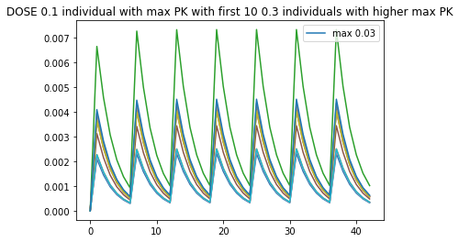
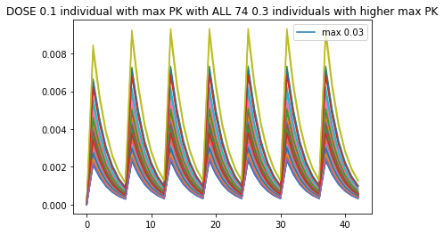

Slide 11
Train on 0.03 PKPD to predict 0.1 individuals with PK > max PK of 0.03

Slide 12
Previous slide reflection
Train on 0.03 PKPD to predict 0.1 individuals with PK > max PK of 0.03
The model does not know what to do with the higher dose of 0.1 because it has only been trained on 0.03. However, it is still able to make some adjustments based on the PK data. For this reason the predictions are not as good as the ones with more training doses.

Slide 13
Train on 0.03 and 0.1 PKPD to predict 0.3 individuals with PK > max PK of 0.1
*sorry graph legends are mislabeled the order is 0.03, 0.1, 0.3, 1.0, 3.0, 10.0, 30.0

Slide 14
Train on 0.03, 0.1, and 0.3 PKPD to predict 1.0 individuals with PK > max PK of 0.3
*sorry graph legends are mislabeled the order is 0.03, 0.1, 0.3, 1.0, 3.0, 10.0, 30.0

Slide 15
Train on 0.03, 0.1, and 0.3, 1.0 PKPD to predict 3.0 individuals with PK > max PK of 1.0

